Slide 1
PROJECT TITLE: DOCTOR APP
PIP2001 Capstone Project
Review-1
Batch Number:ISR-G02
Under the Supervision of,
Dr./Mr./Ms./Prof. MOHAMMADI AKHEELA KHANUM
Professor / Associate Professor / Assistant Professor
School of Computer Science and Engineering
Presidency University
Roll Number | Student Name
20211ISR0080 | KK AKSHAY
20211ISR0083 | PAVAN RAM A
20211ISR0041 | PRAJWAL R NAIRY
20211ISR0077 | VAIBHAV D PETE
Name of the Program: B.TECH
Name of the HoD: DR. ZAFAR ALI KHAN
Name of the Program Project Coordinator: MOHAMMADI AKHEELA KHANUM
Name of the School Project Coordinators: Dr. Sampath A K / Dr. Abdul Khadar A / Mr. Md Ziaur Rahman

Slide 2
Introduction
We are making a project called “DOCTOR APP” where we help the doctors plan their appointments, out patient and in patient care
Managing appointments efficiently is essential for doctors to maintain a smooth workflow because it directly impacts their ability to provide timely and effective care to their patients.
When appointments are organized and aligned with a doctor's availability, it reduces the risk of overbooking or scheduling conflicts. This helps doctors to focus on delivering quality care without the pressure of back-to-back consultations or unplanned interruptions.
Effective appointment management also minimizes waiting times for patients and ensures that their needs are addressed promptly, leading to a better overall experience in the healthcare setting.

Slide 3
Literature Review
Automated appointment reminders to reduce no-shows (Jirabhron Chaiwongsai et al., 2016)​
The use of mobile applications to improve doctor-patient interaction (Ekwonwune Emmanuel et al., 2019)
AI-based recommendations for appointment management (Ayman Odeh et al., 2019)
Real-time appointment scheduling and video consultations (S. Usharani et al., 2021)​
Optimization of appointment scheduling using machine learning (Catalina Valenzuela-Núñez et al., 2024)

Slide 4
Advantages and Disadvantages
Automated appointment reminders to reduce no-shows (Jirabhron Chaiwongsai et al., 2016)​
Advantages
Reduced No-Show Rates: Automated appointment reminders help in significantly reducing the number of missed appointments by sending timely notifications to patients. This leads to improved clinic efficiency and better utilization of doctors' time, ultimately enhancing the overall quality of patient care.
Disadvantages
Reliance on Technology: The effectiveness of automated reminders depends on patients' access to and engagement with the technology. If patients do not have reliable internet access, do not regularly check their devices, or are not comfortable with digital tools, they may still miss appointments despite the reminders.

Slide 5
Advantages and Disadvantages
The use of mobile applications to improve doctor-patient interaction (Ekwonwune Emmanuel et al., 2019)
Advantages
Enhanced Accessibility: Mobile applications make it easier for patients to access healthcare services and communicate with their doctors anytime and anywhere. This leads to faster response times and improved patient satisfaction, as they can receive medical advice or updates without the need to visit the clinic in person.
Disadvantages
Privacy and Security Concerns: The use of mobile applications in healthcare raises concerns about the privacy and security of patient data. If not properly managed, sensitive medical information could be vulnerable to unauthorized access or data breaches, posing a risk to patient confidentiality.

Slide 6
Advantages and Disadvantages
AI-based recommendations for appointment management (Ayman Odeh et al., 2019)
Advantages
Optimized Scheduling: AI-based recommendations can analyze patterns in appointment data and suggest optimal scheduling times for both doctors and patients. This leads to a more efficient use of time, reducing waiting times for patients and minimizing gaps in the doctor's schedule, ultimately improving the overall workflow.
Disadvantages
Data Dependency: The effectiveness of AI-based recommendations heavily depends on the quality and accuracy of the data used. If the data is incomplete or outdated, the AI might provide incorrect recommendations, which could lead to scheduling conflicts or inefficiencies in managing appointments.

Slide 7
Advantages and Disadvantages
Real-time appointment scheduling and video consultations (S. Usharani et al., 2021)
Advantages
Convenience and Flexibility: Real-time appointment scheduling and video consultations allow patients to book appointments and consult with doctors from the comfort of their homes. This flexibility reduces the need for in-person visits, saving time and making healthcare more accessible, especially for those in remote areas.
Disadvantages
Technical Limitations: The effectiveness of video consultations depends on the availability of stable internet connections and suitable devices. Patients or doctors with poor connectivity or outdated technology may experience disruptions, which can affect the quality of the consultation and lead to communication issues.

Slide 8
Advantages and Disadvantages
Optimization of appointment scheduling using machine learning (Catalina Valenzuela-Núñez et al., 2024)
Advantages
Increased Efficiency: Machine learning algorithms can analyze large volumes of data to identify patterns in patient behavior and predict the best appointment times. This leads to more efficient scheduling, reducing waiting times for patients and ensuring that doctors' schedules are better utilized.
Disadvantages
Complexity and Implementation Costs: Implementing machine learning solutions for appointment scheduling can be costly and complex. It requires significant investment in technology, data infrastructure, and skilled personnel, which may be challenging for smaller healthcare facilities with limited resources.

Slide 9
Research papers | Author | Year | Methodology used
Automated appointment reminders to reduce no-shows | Jirabhron Chaiwongsai | 2016 | providing consistent outreach to patients and giving them multiple opportunities to confirm or cancel their appointment
The use of mobile applications to improve doctor-patient interaction | Ekwonwune Emmanuel | 2019 | This methodology provides a comprehensive approach to evaluating the role of mobile applications in enhancing doctor-patient interaction, helping to generate meaningful insights for healthcare improvements
AI-based recommendations for appointment management | Ayman Odeh | 2019 | This methodology ensures a comprehensive approach to evaluating AI-based recommendations for appointment management, with a focus on efficiency, patient satisfaction, and operational improvements.
Real-time appointment scheduling and video consultations | S. Usharani | 2021 | This methodology offers a comprehensive approach to studying real-time appointment scheduling and video consultations, focusing on both technology performance and user experience to enhance healthcare delivery.
Optimization of appointment scheduling using machine learning | Catalina Valenzuela-Núñez | 2024 | This methodology provides a comprehensive approach to developing and evaluating machine learning models for optimizing appointment scheduling, ensuring that the solution is effective, scalable, and user-friendly in real-world healthcare environments

Slide 10
Proposed Method
1.Key Features
Patient Module:
Search for doctors by specialization, location, and availability.
Book, reschedule, or cancel appointments.
Access medical records, prescriptions, and past consultations.
Notifications for appointments
Doctor Module:
Manage profile, schedule, and availability.
View patient history and medical records.
2. Technology Stack
Frontend: React Native for mobile
Backend: Node.js with MongoDB.
Cloud: Hostinger

Slide 11
Objectives
Improve Accessibility – Enable patients to easily book appointments
Streamline Scheduling – Help doctors and patients manage appointments efficiently.
Enhance Communication – Facilitate smooth doctor-patient interaction through chat
4.Boost Patient Engagement – Send reminders to patients

Slide 12
Methodology/Modules
Methodology:
Requirement Analysis: Gather user needs and define core features.
Design & Planning: Create wireframes (e.g.,Node.js).
Development:
Frontend: Build mobile/web interfaces.
Backend: Develop APIs, databases, and authentication.
Integration: Add payment gateways, and notifications.
Testing: Conduct functional, security, and performance testing.
Deployment & Launch:

Slide 13
Methodology/Modules
Modules:
Patient Module: Appointment booking, reminders.
Doctor Module: Manage profile, schedule, appointments
Communication Module: Enable chat, and notifications.

Slide 14
Software components
1 Front-End:HTML, CSS, JavaScript
2. Back-End: Language: Kotlin
Database: MySQL
Frame work: Angular JS
3. DevOps and Deployment:
Version Control: GitHub
Cloud Providers: Hostinger

Slide 15
Hardware Components
1. Development:
Computers: Windows/Linux
Mobile Devices: Android devices
2. Deployment:
Cloud Infrastructure: AWS
3. Testing:
Test Devices: Android devices

Slide 16
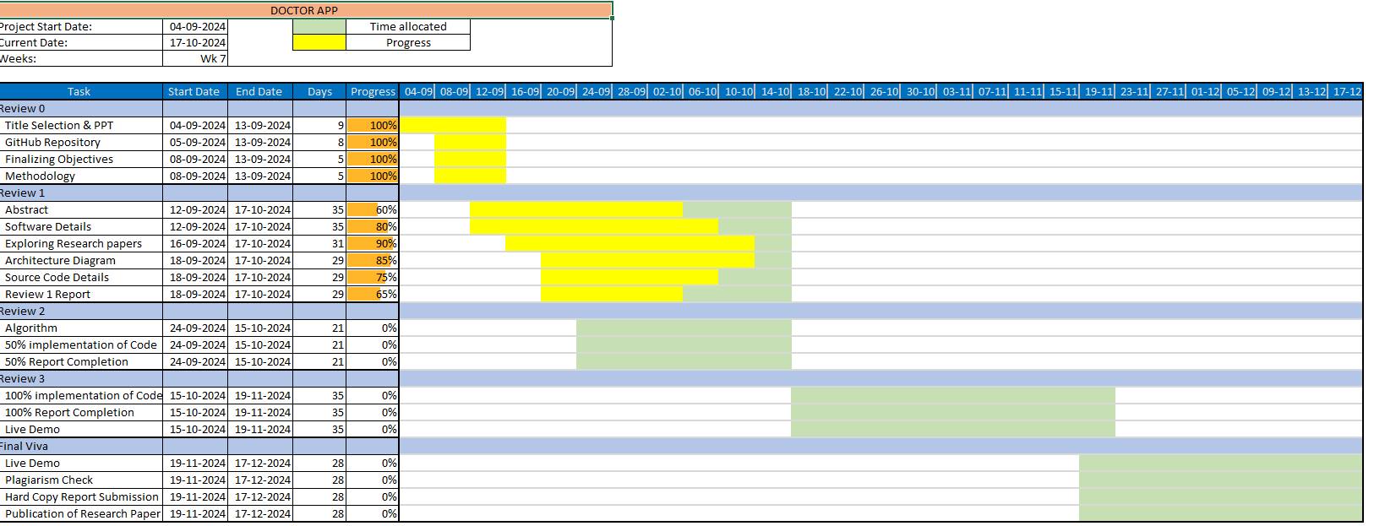
Timeline of Project

Slide 17
Expected Outcomes
1. Efficient Appointment Management: Simplified scheduling and management of appointments for both patients and doctors.
2. Improved Patient Record Keeping: Secure storage and easy access to patient records and medical history.
3. Enhanced User Experience: User-friendly interface with features like real-time notifications and in-app chat for better communication.
4. Increased Accessibility to Healthcare: Easier access to a variety of doctors and specialists, especially for patients in remote areas.

Slide 18
Github Link
The Github link provided should have public access permission.
Github Link
https://github.com/Akshay-reddy-max/Doctor-app/tree/main

Slide 19
Conclusion
Our project is mapped to help the doctors in managing the appointments on their own
We will enable the patients to book appointments through the app
We will enhance the communication as there will be smooth doctor-patient interaction through chat
We will send the reminders to the patients through the app

Slide 20
References
https://www.scirp.org/journal/paperinformation?paperid=95957#:~:text=Better%20communication%20can%20also%20take,to%20a%20reduction%20in%2costs.
https://www.sciencedirect.com/science/article/abs/pii/S221188372300104
https://onlinelibrary.wiley.com/doi/10.1155/2022/581913
https://www.researchgate.net/publication/3763945_Smart_Medical_Appointment_Scheduling_Optimization_Machine_Learning_and_Overbooking_to_Enhance_Resource_Utilization

Slide 21

Project work mapping with SDG

Slide 22
Thank You

